Slide 1
The True Measurement of Video Quality: Pixel vs. TVL
Video Quality

Slide 2
Introduction
This section will bring you through the following concepts about:
1. What are the 3 resolution standards in CCTV industry-Pixels, TVL and scan lines
2. The key to more image details-Pixels
3. The true measurement of video quality-TVL

Slide 3
Agenda
● What’s Crucial in a Surveillance Scene Image?
● How Do I Measure the Amount of Details I Can Get?
--Resolution
--Scan Line: NTSC & PAL
--Pixels
--From Analog to Digital
--Why Mega Pixels Matters
--HD Resolution in Surveillance Cameras
--More than the Pixels
--The Factors Influencing Video Quality
--TV Lines
--How to Measure the TVL Value
● Conclusion
--Important Facts about Video Quality

Slide 4


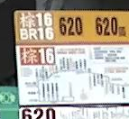



What’s Crucial in a Surveillance Scene Image?
● Details = Information = Evidence
Notes:
In a surveillance scene, the mission of the camera is to capture as more details in an image as possible.
Bcoz the visual details give us the information like numbers, characters, colors and movements as hard evidence.
Take this 1.3M photo for example, most of the crucial details like Car Plate Number, Bus Stop, or Poster are clear enough to see, and thus very become useful information of this scene.

Slide 5
How Do I Measure the Amount of Details I Can Get?

Slide 6
Resolution
● How do we measure the image details the camera can produce?
“Resolution”
● Measurement
Example | Measurement | System
525 lines (NTSC) | Scan line | Analog
540 TV lines | TV line | Analog / Digital
1280X1024 pixels | Pixel | Digital
Notes:
“Resolution” is the commonly-used criteria we use to judge the amount of details in an image
Earlier, the resolution in analog system was typically specified in terms of “Scan lines”
The scan lines were used in TV broadcasting system, which defines the number of horizontal rows used to display an image on CRT screens.
TV line, a specification generally used in CCTV industry, refers to the horizontal resolution, the number of vertical lines visible in an image. The number of vertical lines is counted horizontally, one next to the other and so on.
For digital products, like digital cameras or DVs, pixels are mostly-used to describe the ability to make details of a device.
When selecting your cameras, TV line and pixel, though different in their nature, should be both adopted to evaluate the resolution performance.

Slide 7
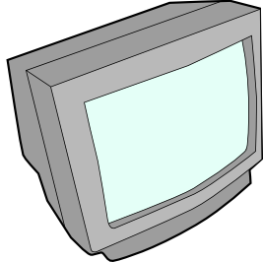

Scan Line: NTSC & PAL
● Scan line:
Horizontal rows displaying an image on CRT screens
● Standards:
NTSC 525 lines; PAL 625 lines
● Scanning method
- Interlaced scanning 1,3,5… then 2,4,6 …
- Progressive scanning 1,2,3,4,5,6…
Notes:
Scan lines represent the horizontal rows displaying an image on CRT screens.
NTSC and PAL standards adopted scan lines measure the video resolution of CRT TVs and PC monitors.
They respectively defined the number of horizontal lines that form a frame on the screen to be 525 and 625 scan lines
By that time, the interlacing scanning method was used to display images.
Interlaced screens display every other line (1-3-5 etc., then 2-4-6, etc.)
Later on, the display device were advanced with the better method: progressive scan, displaying lines consecutively (1-2-3 etc.).
Let’s check out how an image is formed on an interlaced NTSC standard screen.
Out of 525 lines, only 480 are visible
When the picture is sent to a display device, the first field of odd-numbered lines is sent, and then the second field of 240 even-numbered lines is transmitted. Then the lines slot into one another to give the illusion of the complete frame. On the other hand, with progressive scanning method, the lines are produced one after one.
The main promise of joy with digital HDTV (High Definition Television) is its much greater resolution. HDTV pixels are smaller and squarer than NTSC pixels, so HDTV can resolve finer details and hold smoother curves. Plus, you get considerably more pixels to look at. HDTV has a total of 1,125 scan lines, but it only uses 1,080 of these for the actual image (hence the "1080i" HDTV specification). There are 1,920 pixels in each interlaced scan line, so our HDTV pixel calculation looks like this: 1,080 scan lines x 1,920 pixels/line = 2,073,600 pixels Rounded off, an HDTV set gives us about 2 million total pixels, about six times the number of NTSC pixels. Obviously, there's a lot more visual potential with HDTV, something that also makes its movie-like 16 x 9 aspect ratio possible. NTSC only gives a 4 x 3 aspect ratio, which ends up whacking off the ends of a normal movie. You just can't see all those gladiators waiting in the wings like you can with HDTV.

Slide 8





Pixels
● Pixel : smallest units of a digital image
Example
1280 x 1024 pixels
= 1,310,720 pixels
= 1.3 Megapixels (MP)
Original
Enlarged
● Higher number of pixels = more details
25X25 50X50 100X100
Notes:
Pixels, are the smallest units that form an digital image.
If we enlarge a portion of this picture, like, the parcel next to the worker, we can see clearly the individual pixels rendered as little squares.
In a camera spec you may have seen this kind of “number set” representing the resolution value
That means, the camera can produce an image composed of 1280 pixels in width and 1024pixels in height.
As a total of 1,310,720 pixels or, 1.3 megapixels.
How does the number of pixels influence the image clarity?
Let’s look at the pictures below.
You can observe how the same image could appear at different pixel resolutions.
It’s obvious that 100x100 pixels describe the same picture much clearer than 25X25 pixels do.
So the fact is quite simple: Higher number of pixels means more details

Slide 9

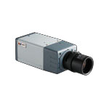
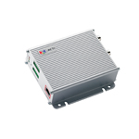
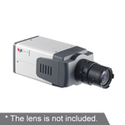
From Analog to Digital
● Video display quality was limited due to the incapability of CRT display devices
● Analog signal + Encoder = Digital signal
More details can be seen on digital
display devices
Analog
Digital
Analog Camera
Encoder
Digital
IP Camera
Digital Display
Standard | Scan Lines
NTSC | 525 lines
PAL | 625 lines
Resolution Name | Pixels ( WxL)
D1 | 720 x 480 (NTSC) 720 x 576 (PAL)
Notes:
While CRT monitors were still the main display device, the video resolution that can be presented on the screen was restricted by the 525 scan lines for NTSC, 625 scan lines for PAL.
With the video encoder, the video from analog cameras could be converted into digital signals, which then is able to be presented on advanced display devices such as LCDs. That means, we could see clearer images on the screens as many details as the video stream can provide.
Thus, in terms of digital resolution, the NTSC standard vide stream, after converted, is 720 pixels/line X 480 scan lines = 345,600 pixels
Along with PAL, were called D1 resolution.

Slide 10
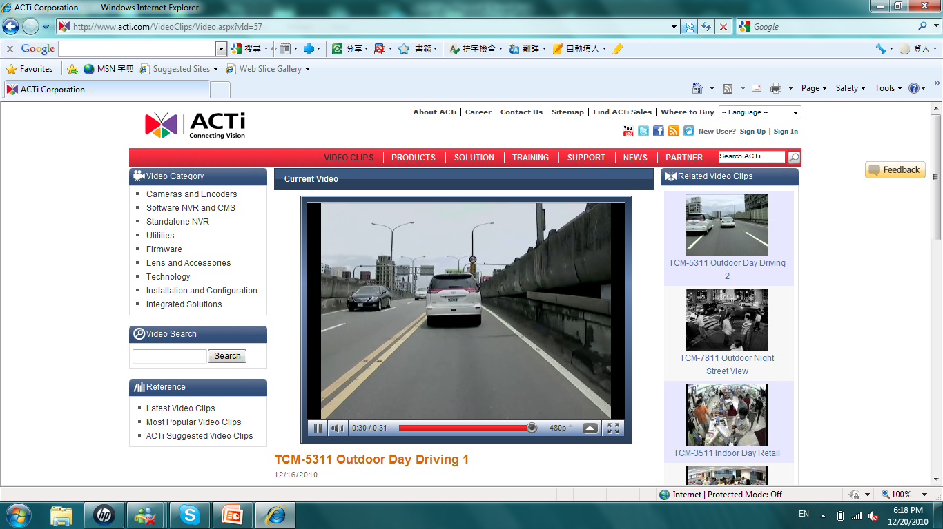


Why Megapixel Matters
● The growth of pixel number in CCTV industry
Analog
Cameras
+ Encoder
Resolution Name | Pixels ( WxL) | MP
D1 | 720 x 480 (NTSC) 720 x 576 (PAL) | 0.3 0.4
SXGA | 1280X1024 | 1.3
QXGA | 2048X1536 | 3
Network
cameras
8960 XY
Non-mega pixel
Mega pixel
Notes:
Looking at the growth of resolution technology in CCTV industry, you will observe that it’s almost the evolution history of pixel number.
In the video surveillance market, D1(NTSC/PAL) resolution cameras were once the main stream in the market, which were the maximum resolution the conventional analog cameras can provide after the video signal was converted into a digital video stream.
With the resolution of 1MP, 3MP, 5MP, and even 10MP network cameras being introduced to the market, the term “megapixel” has just become the most required resolution for various camera models.
You might be confused with how “megapixel” benefits the video industry.
The truth is, megapixel promise a relatively higher quantity of details comparing with D1.
For details such as the car plate number, cameras with d1 resolution may be able to see it, but its application is very limited to few scenarios with the conditions like: fixed objects, close distance, accurate lens adjustment.
In the road scene we see below, a non-megapixel camera is unlikely to capture the details on the car plate of a moving-away vehicle; while the megapixel camera can easily do it.

Slide 11
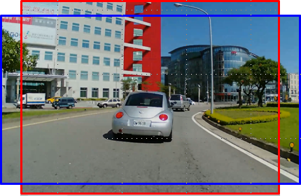
HD Resolution in Surveillance Cameras
● “High Definition” video format
A higher, standardized display format using the resolution aspect ratio as 16:9
Better than the NTSC/PAL format
Best matches human eyes
4:3
● Display Aspect Ratio
4:3 General TVs
16:9 HDTVs
16:9
Notes:
You may also care about the High Definition resolution format.
This format was defined to standardize a higher display format using the resolution aspect ratio as 16:9, which is better than traditional analog standard, supporting the wider picture corresponds much better to the human visual field than the almost square 4:3
The conventional TV monitors mostly come with display aspect ratio of 4:3, while the cameras on market can meet this need.
Since the high definition TVs are adopting the image aspect ratio from 4:3 to 16:9

Slide 12
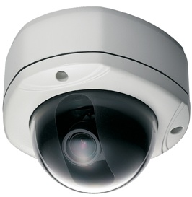


● Standard requirements
Aspect ratio, resolution, scanning, frame rate
Resolution Name | Pixels ( WxH) | Display Ratio
VGA | 640X480 | 4:3
HD 720p | 1280X720 | 16:9
SXGA | 1280X1024 | 4:3
Full HD 1080p | 1920X1080 | 16:9
● HD visual outcome
= HD resolution video + HD display device
HD Video
HD Display Device
Notes:
To meet this standard, the display device , like an HDTV, should fully meet certain requirements:
Aspect ratio, resolution, scanning, and frame rate
This standard has 2 main specs, 720p and 1080p
The so-called HD standard means the resolution with 720 vertical pixels recorded by progressive scanning method; likewise, Full HD refers to the resolution with 1080 vertical pixels recorded progressive scanning method.
It’s a must for cameras to conform to the new standard.
With megapixel resolution, IP cameras are flexible to produce images with different aspect ratios to fulfill different needs.
In conclusion, to achieve the high definition visual outcome, with your HD display device, the cameras should also be capable of generating HD resolution video.

Slide 13


More than the Pixels
● Higher number of pixels DOES NOT guarantee better video quality!
250X130 pixels
375X295 pixels
● Some high megapixel cameras in the market MAY produce image with low clarity even if its lens is well-adjusted!
Miss needed details
Waste bandwidth and storage space
Notes:
While the high-end cameras keep going up and up in pixel number, is this capability the true answer to higher requirements for seeing clearer images ?
The fact is: higher number of pixels DOES NOT guarantee better video quality
If we look at the 2 images with different resolution.
With simple visual observation, you can tell that the image quality of the left picture is much better than the right one.
The details are very clear on the left but quite blurry on the right. Yet in both cases the lens was adjusted to the best possible focus.
It ‘s very likely that your high megapixel camera produces images with high pixel count but low clarity even if the lens is well adjusted.
Therefore, you not only miss all the needed details, but waste your bandwidth and storage space.
for we are already aware that higher number of pixels means better resolution. It’s no wonder to see that more and more high end megapixel cameras keep going up with the pixel number. up n nowadays video security industry, the high end mega pixel” cameras have been the most competitive seem
One of the most confusing and difficult topics in the CCTV world is resolution. Most of us have digital cameras or video camcorders and have heard the term megapixel used as the most common comparison in resolution between various makes and models. We are also aware that a larger number means better picture quality, but many people do not know why. In the CCTV security camera world, though, most cameras are still analog and their resolution is measured differently from what we are used to.

Slide 14


The Factors Influencing Video Quality
● The process of an image being produced by a camera:
Object
Lens
Sensor
Image
Signal
Processor
Com-
pression
Decom-
pression
Image
● The direct outcome of the image production
The snapshot
Notes:
The resolution, which is mainly determined by the sensor, is merely a part in the image production process, which includes many stages.
The light reflected from the object passes through the lens, subsequently hits the sensor, and is converted into electronic signals to be processed by the ISP, then compressed into a video stream.
After the stream is decompressed, the display device finally outputs the image.
As you may see, improving only the image sensor resolution of video processing gives little real improvement for the outcome.
The simplest and most direct way to examine the image quality would be: to check the image outcome, the snapshot

Slide 15
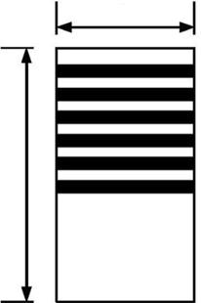
TV Lines
● TVL = the maximum number of alternating light +
dark lines that can be resolved on the image
The numeric value representing the accumulated effort = lens + sensor + ISP + compression
Practical for both analog CCTV and IP surveillance
Width
Example
400 TV Lines
=200 distinct vertical dark lines + 200 distinct vertical white lines
Height
● Higher number of TVLs
= More detailed and clear image
Notes:
Now that you know that high resolution does not guarantee high quality and clear details, you might want to know how to evaluate the final output from different Multi-Megapixel cameras and compare them to each other.
There exists a method that can give you a simple and clear single numeric value that represents the accumulated effort of lens, sensor, ISP and compression!
It is called “Television Lines”, measured from the final output
It is a classic quality measurement in analog CCTV and can be used in IP surveillance as well.
TVL is defined as the maximum number of alternating light and dark lines that can be resolved. A resolution of 400 TVL means that 200 distinct dark lines and 200 distinct white lines can be counted over a horizontal span equal to the height of the picture!
In other words TVL shows the true horizontal resolution of an image – the higher TVL, the clearer the image is.

Slide 16
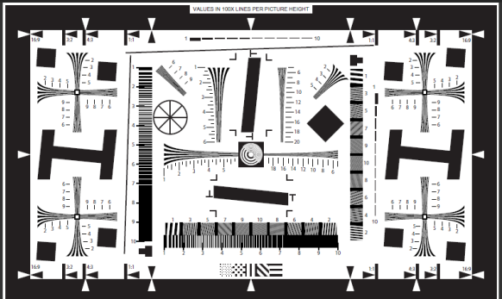
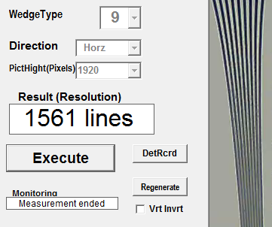
How to Measure the TVL Value
You only need the 4 things:
1. Your camera
2. A printed TVL resolution chart
3. A PC
ISO 12233
4. A TVL checker software
(e.g. Olympus Hyres 3.1)
Notes:
Now you have understood that TVL is the true measurement of video quality regardless of the pixels.
Let’s move on to check the TVL value of your camera.
You only need for things to complete the test.
The procedures are quite simple:
1. Use the camera to capture a snapshot of the printed TVL resolution chart. A printed TVL resolution chart
The ISO 12233 chart is an ISO standard for visual assessment of camera resolution, it’s available from the International Standards Organization and under copyright protection.
2. Export the snapshot to a PC
3. Use a TVL checker software to analyze the image produced by the camera and tell the resolution value. You may
4. The software will analyze the trimmed area and tell the TVL value.

Slide 17
Conclusion

Slide 18
Important Facts about Video Quality
● High megapixels promise more details to be included in an image
● High definition visual outcome
= HD video (720p, 1080p)+ HD display device
● TVL= true measurement of final video quality
Fair and Accurate
TVL testing is affordable and simple
Notes:
As a conclusion, let’s quickly go over the important facts about the video quality.

